Slide 1




MASTER PROGRAM IN
DATA SCIENCE AI & MACHINE LEARNING
www.mcta.co.in

Slide 2



Association Rule Mining - Market Basket Analysis
www.mcta.co.in
www.mcta.co.in

Slide 3
Contents covered
Apriori
- Implement market basket analysis using Apriori algorithm
2) FP Growth
- Implement market basket analysis using FP Growth graph method
www.mcta.co.in

Slide 4
Apriori
Apriori algorithm is used predominantly in finding association between 2 or more objects
In retail sector, it helps the business to determine if a customer buys bread then he is more likely to buy jam alongside too hence they are kept next to each other
Association Rule Mining
Association Rule Mining is used when you want to find an association between different objects in a set, find frequent patterns in a transaction database, relational databases or any other information repository. The applications of Association Rule Mining are found in Marketing, Basket Data Analysis (or Market Basket Analysis) in retailing, clustering and classification.
www.mcta.co.in

Slide 5
Apriori
The most common approach to find these patterns is Market Basket Analysis, which is a key technique used by large retailers like Amazon, Flipkart, etc to analyze customer buying habits by finding associations between the different items that customers place in their “shopping baskets”. The discovery of these associations can help retailers develop marketing strategies by gaining insight into which items are frequently purchased together by customers. The strategies may include:
Changing the store layout according to trends
Customer behavior analysis
Catalog design
Cross marketing on online stores
What are the trending items customers buy
Customized emails with add-on sales etc..
www.mcta.co.in

Slide 6
Apriori
Difference between Association and Recommendation
Association rules do not extract an individual's preference, rather find relationships between sets of elements of every distinct transaction. This is what makes them different than Collaborative filtering which is used in recommendation systems.
To understand it better take a look at below snapshot from amazon.com and you notice 2 headings “Frequently Bought Together” and the “Customers who bought this item also bought” on each product’s info page.
“Frequently Bought Together” → Association
“Customers who bought this item also bought” → Recommendation
www.mcta.co.in

Slide 7
Apriori
Apriori Algorithm
Apriori algorithm assumes that any subset of a frequent itemset must be frequent. Its the algorithm behind Market Basket Analysis.
Say, a transaction containing {Grapes, Apple, Mango} also contains {Grapes, Mango}. So, according to the principle of Apriori, if {Grapes, Apple, Mango} is frequent, then {Grapes, Mango} must also be frequent.
Here is a dataset consisting of six transactions. Each transaction is a combination of 0s and 1s, where 0 represents the absence of an item and 1 represents the presence of it.
www.mcta.co.in

Slide 8
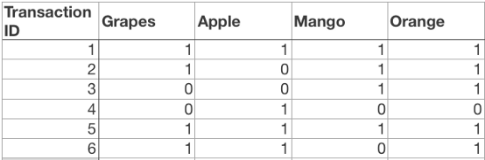
Apriori
In order to find out interesting rules out of multiple possible rules from this small business scenario, we will be using the following matrices:
www.mcta.co.in

Slide 9
Apriori
Support: Its the default popularity of an item. In mathematical terms, the support of item A is nothing but the ratio of transactions involving A to the total number of transactions.
Support(Grapes) = (Transactions involving Grapes)/(Total transaction)
Support(Grapes) = 0.666
Confidence: Likelihood that customer who bought both A and B. Its divides the number of transactions involving both A and B by the number of transactions involving B.
Confidence(A => B) = (Transactions involving both A and B)/(Transactions involving only A)
Confidence({Grapes, Apple} => {Mango}) = Support(Grapes, Apple, Mango)/Support(Grapes, Apple)
= 2/6 / 3/6
= 0.667
www.mcta.co.in

Slide 10
Apriori
Lift : Increase in the sale of A when you sell B.
Lift(A => B) = Confidence(A, B) / Support(B)
Lift ({Grapes, Apple} => {Mango}) = 1
So, likelihood of a customer buying both A and B together is ‘lift-value’ times more than the chance if purchasing alone.
Lift (A => B) = 1 means that there is no correlation within the itemset.
Lift (A => B) > 1 means that there is a positive correlation within the itemset, i.e., products in the itemset, A, and B, are more likely to be bought together.
Lift (A => B) < 1 means that there is a negative correlation within the itemset, i.e., products in itemset, A, and B, are unlikely to be bought together.
Association Rule-based algorithms are viewed as a two-step approach:
www.mcta.co.in

Slide 11
FP Growth
FP-Growth: allows frequent itemset discovery without candidate itemset generation. Two step approach:
Step 1: Build a compact data structure called the FP-tree
Built using 2 passes over the data-set.
Step 2: Extracts frequent itemsets directly from the FP-tree
www.mcta.co.in

Slide 12
Step 1: FP-Tree Construction
FP Growth
FP-Tree is constructed using 2 passes over the data-set:
Pass 1:
Scan data and find support for each item.
Discard infrequent items.
Sort frequent items in decreasing order based on their support.
Use this order when building the FP-Tree, so common prefixes can be shared.
www.mcta.co.in

Slide 13
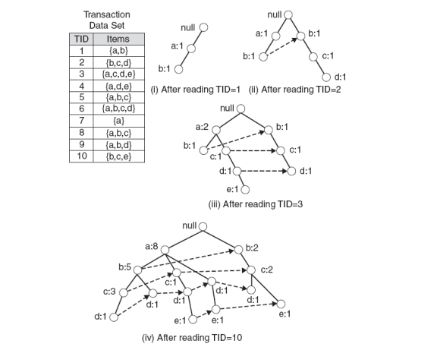
Step 1: FP-Tree Construction (Example)
www.mcta.co.in

Slide 14
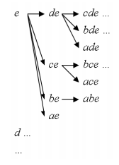
Step 2: Frequent Itemset Generation
Each prefix path sub-tree is processed recursively to extract the frequent itemsets. Solutions are then merged.
E.g. the prefix path sub-tree for e will be used to extract frequent itemsets ending in e, then in de, ce, be and ae, then in cde, bde, cde, etc.
Divide and conquer approach
www.mcta.co.in

Slide 15
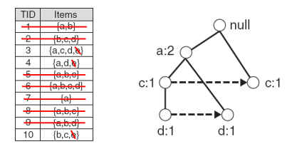
Conditional FP-Tree
The FP-Tree that would be built if we only consider transactions containing a particular itemset (and then removing that itemset from all transactions).
I Example: FP-Tree conditional on e.
www.mcta.co.in

Slide 16
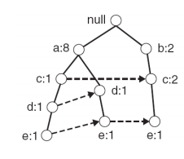
Example
Let minSup = 2 and extract all frequent itemsets containing e.
1. Obtain the prefix path sub-tree for e:
www.mcta.co.in

Slide 17
Example
2. Check if e is a frequent item by adding the counts along the linked list (dotted line). If so, extract it.
Yes, count =3 so {e} is extracted as a frequent itemset.
3. As e is frequent, find frequent itemsets ending in e. i.e. de, ce, be and ae.
4. Use the the conditional FP-tree for e to find frequent itemsets ending in de, ce and ae
Note that be is not considered as b is not in the conditional FP-tree for e.
I For each of them (e.g. de), find the prefix paths from the conditional tree for e, extract frequent itemsets, generate conditional FP-tree, etc... (recursive)
www.mcta.co.in

Slide 18
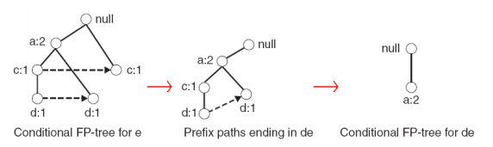
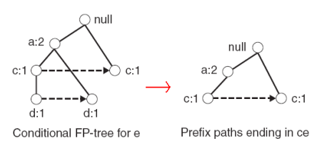
Example
Example: e -> de -> ade ({d,e}, {a,d,e} are found to be frequent)
Example: e -> ce ({c,e} is found to be frequent)
www.mcta.co.in

Slide 19
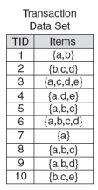
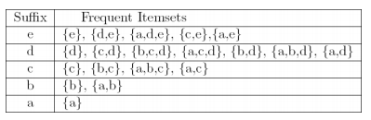
Example
Frequent itemsets found (ordered by sufix and order in which they are found):
www.mcta.co.in

Slide 20
Example
Advantages of FP-Growth
only 2 passes over data-set
“compresses” data-set
no candidate generation
much faster than Apriori
Disadvantages of FP-Growth
FP-Tree may not fit in memory!!
FP-Tree is expensive to build
www.mcta.co.in

Slide 21
Association rule
Trivia
Please solve the following questions
Q1) What is Apriori algorithim
Q2) What is support, confidence and lift
Q3) What is FP Growth and where is it used
Q4) What are the advantages and disadvantages of FP growth
www.mcta.co.in

Slide 22

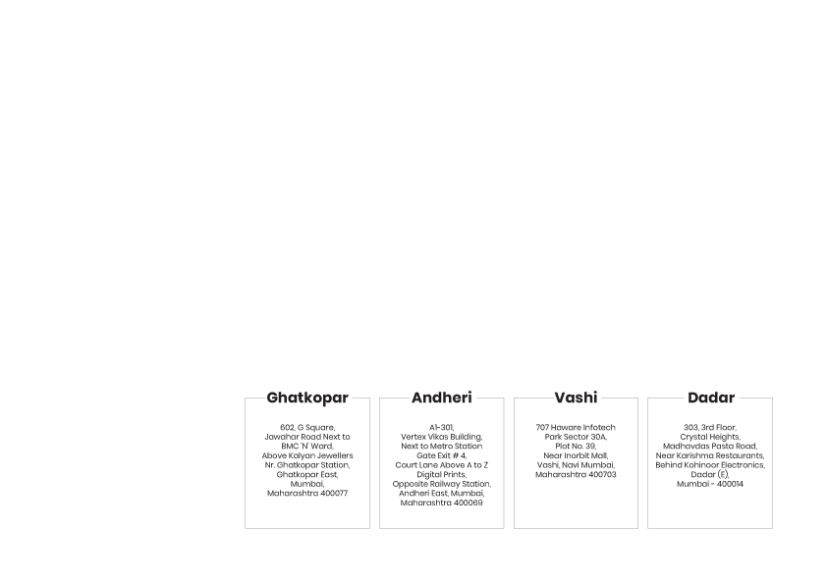
BE AN EXPERT DATA SCIENTIST!
www.mcta.co.in

